Slide 1
Mass Payments POC

Slide 2
Payments Mass Payments - Overview
Objective: Give clients to ability to process large payment runs through the Volopa business platform, such as a payments file of 5,000 to 15,000 payments
Location: Payments >> Batch Payments >> File Uploads
Tasks:
File Upload
Impacted Sections:
Admin.volopa
UI – New journey to download templates and upload payments files

Slide 3
1. Download CSV with Latest List of Recipients
Feature: Provide a button for clients to download the latest CSV file containing recipient details.
Can download a list of recipients per currency (1 currency at a time)
Content: The CSV should include up-to-date recipient information such as Recipient ID, name, bank country, account currency, and email addresses.
2. CSV Template
Feature: Generate a CSV template pre-filled with the client’s recipient details.
Columns:
Recipient ID
Client Recipient ID
Recipient Name
Recipient Bank Country
Recipient Account Currency (1 currency)
Available Settlement Methods (Values: Priority ; Regular ; Priority and Regular)
Recipient Email Address
CC Email Address
Payment Amount (blank for client input)
Settlement Method (dropdown: Priority, Regular)
Payment Reason
Payments Reference
Purpose of Payment Code (dropdown, dependent on Bank Country and Account Currency)
Invoice Number (required if Account Currency is INR)
Invoice Date (required if Account Currency is INR)
Incorporation_number (added for business Recipients with TRY )
Rows:
CSV should allow up to 10,000 rows (i.e. payments) per file
3. Drag and Drop Box for Upload
Feature: Implement a drag-and-drop box or an upload button for the client to upload the completed payments file.
Functionality: Allow clients to upload the filled CSV file for processing.
4. File Validation
Feature: Validate the uploaded file for formatting errors and value errors.
Checks:
Correct file format (CSV).
Presence of required fields/columns/file structure
Does not exceed the maximum number of payments – 10,000
Valid data entries (e.g., proper email format, valid country & currency codes, Purpose codes, payment types etc)

Slide 4
Lofi Wire Frames

Slide 5
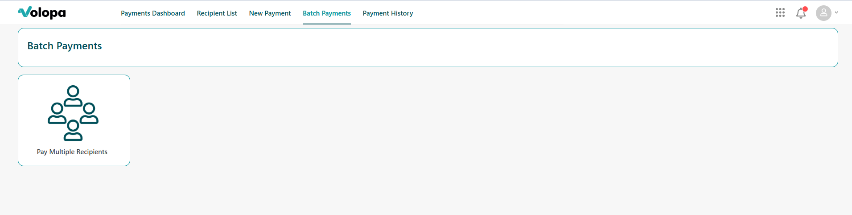

Payments File Upload - Location
File Upload

Slide 6
Payments File Upload – Journey 1
File Upload
1
Download file template here:
CCY v
Download payments file
2
Fill in the template with the payments information. For a guide on how to fill your payments file template, please refer to this user guide here
Completing the file upload template
3
Upload your completed payments file for processing
4
Review your file
Review file
Notes:
File Upload: Client’s Payee ID (so that the client can map Volopa’s payee ID to their internal Client Payee ID)

Slide 7

Payments File Upload – Journey 2
File Upload
1
Download file template here:
Download file template
Reviewing your payments file
2
Fill in the template with the payments information. For a guide on how to fill your payments file template, please refer to this user guide here
Completing the file upload template
3
Upload your completed payments file for processing
4
Review your file
Review file

Slide 8


Payments File Upload – Journey 3
File Upload
Your payments file summary:
File Format
File Structure
File Summary
Total Number of payments – 4,300
Breakdown:
EUR – 4,250
Errored payments: 50
Click here to view which rows these errors occurred on
Cancel
Proceed

Slide 9
From a technical perspective we would like to create a new service based on “laravel-microservice-template” repository.
This service will:
Allow client to download a template csv generated based on db entries.
Allow the client to upload a file
Verify if it’s a CSV
Check if it respects the maximum row limit
Check if each field respect the column validation rules
Allow client to get the files list with their statuses

Slide 10
routes/api.php
The client request will start from the top routes and from there, matching the path will be consumed by the specific method in the Controller.
UploadController
FileController
uploadPaymentCSV
checkUploadStatus
downloadFileTemplate
getAllBeneficiariesByFileId
approveFile
getFileSummary
getFileErrorsList
updateFileStatus
getDraftFilesForClient
getAllUploadedFilesForClient
deletedFile
app/Jobs/ProcessCSV.php
Each Controller will use either dedicated services, dispatch a job or directly the model to respond to the request.
__construct(PaymentFileUpload $paymentFileUpload)
app/Services/PaymentCSVValidator.php
app/Exports/BeneficiariesTemplateExport.php
__construct(PaymentFileUpload $paymentFileUpload)
initializeValidators(): array
validateRow(array $data, int $rowNumber): array
logValidationError(int $rowNumber, string $headerName, $providedValue, string $errorMessage): array
__construct(array $headers, array $data)
Volopa standard models
FPS specific models
Account
TccBeneficiary
PaymentFileUpload
PaymentUploadError
PaymentUploadInstruction
Client
TccContact
user_id
client_id
file_name
file_path
currency
funding_currency
summary
total_records
valid_records
failed_records
status
uploaded_at
completed_at
payment_file_upload_id
row_number
header_name
provided_value
error_detail
payment_file_upload_id
beneficiary_id
client_payee_id
cc_email_address
payment_amount
settlement_method
payment_reason
payments_reference
purpose_of_payment_code
invoice_number
invoice_date
ClientFeatures
TccPaymentPurposeCode
Profile
User
TccAccount
10

Slide 11
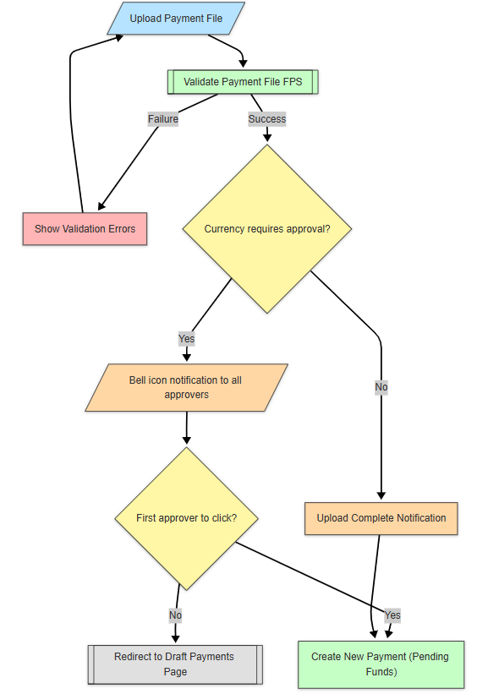
Mass Payment – System Flow for UPLOAD
Upload Payment File
The user initiates the process by uploading a bulk payment file through the platform.
Validate File
The system (FPS service) automatically validates the file content and format.
Validation Outcome:
Failure: ➔ Validation errors are shown. ➔ User must fix and re-upload the file.
Success: ➔ Proceed to approval decision based on currency rules.
Approval Requirement Check:
If approval is NOT required: ➔ Upload is completed immediately. If approval IS required: ➔ Bell icon notification is dispatched to all approvers.
Approver Interaction:
First approver to click notification: ➔ Redirected to Payment Confirmation Page to create the payment.
Other approvers clicking later: ➔ Redirected to Draft Payments Page (payment already picked).

Slide 12
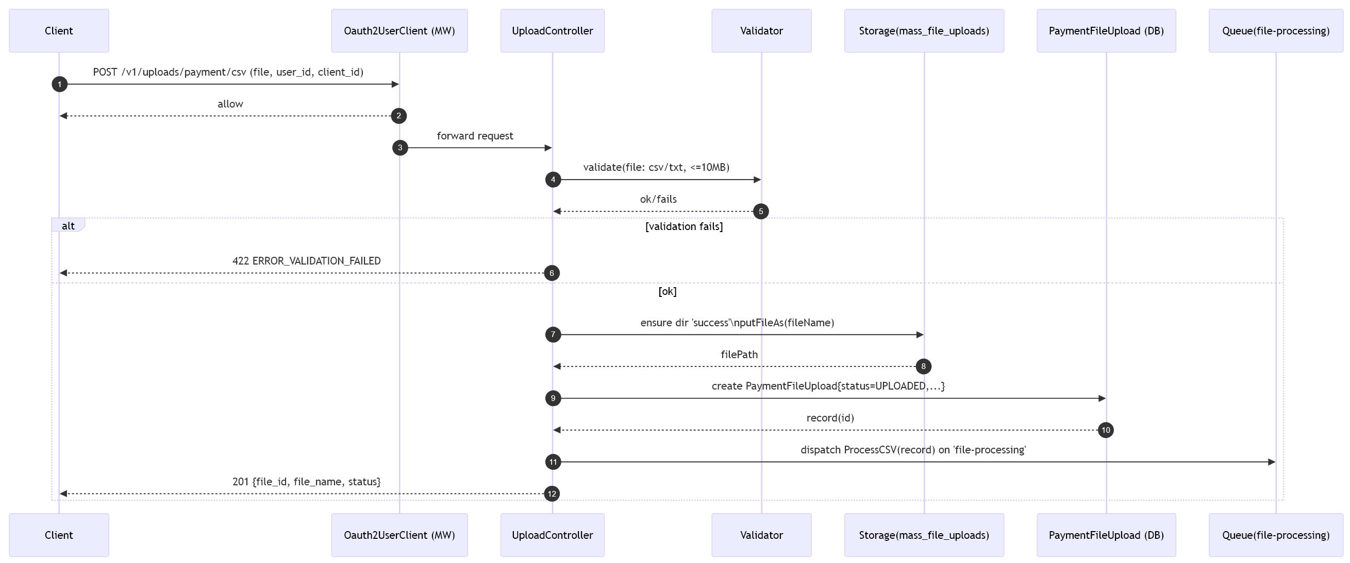
Mass Payment – Upload CSV Sequence diagram

Slide 13
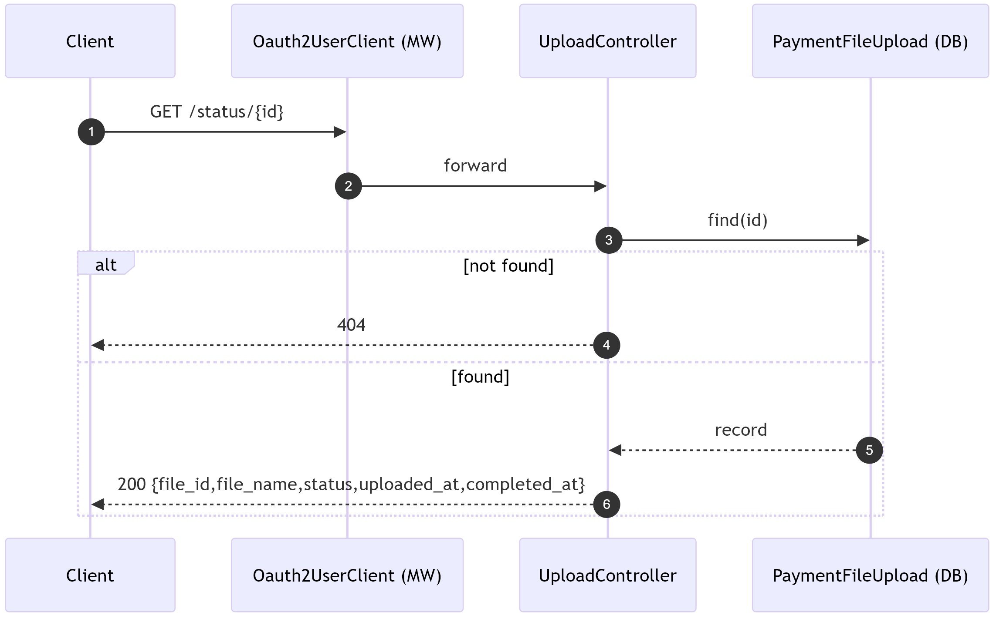
Mass Payment – Get Uploaded CSV status Sequence diagram

